Slide 1
Franklin Parks and Recreation
DECEMBER 2024 Park board Meeting

Slide 2
FACILITY Reservations
• We are still in construction for the concession stand but all is well with that project.
• The summer application process has started. Concession applications are really low so far. Hopefully we can do an online ad for applications and get a lot more over Christmas Break when kids are off of school.
• Beeson Hall has been and will continue to be busy this month. It has hosted 7 Christmas events, the Active Adult Center on Mondays and Wednesday, a couple of classes, and even a wedding.
• We will start taking reservations for 2026 at the beginning of 2025!
- Jamie

Slide 6
FITNESS AND AQUATICS
Aquatics
• We will refurbish the main pool filter early in the year.
• Programming at the middle school has been moved backed and shortened due to their school swim season.
• Started re-hiring process for returning guards.
Group Fitness Classes
• CycleFit instructor was able to gather enough registrations to keep the class going and not lose money.
• The other fitness classes are going well.
• We are launching “Jump Start January” fitness challenge. Those that register for $5 will get:
Email workouts daily during January that can be done at home
Be invited to the Challenge Facebook page for encouragement and support
Entered for a prize drawing at the end of January
- Alfonso

Slide 7
Recreation pROGRAMS
KICKAPOO KIDS CAMP
We are only 40 days until registration day! It is going by so fast!
We have over 350 emails of people who are interested in having their kiddos in camp.
I have received so many applications for kids eager to work at camp this summer.
COMMUNITY GARDEN
The garden is cleaned up for winter time! The guys did a great job and it looks ready to go for March 2025.
Many people have reached out about getting a plot for 2025.
OUR TOWN PLAYERS
They just sent over their 2025 plan! They plan to have multiple shows hopefully at the new active adult center. Confirmed shows are:
A Wedding From Hell
Our Town
An Evening of Shorts and One Acts (Potentially a dinner theater)
PRESCHOOL PLAY
Its going so well! Every Thursday until March. We have had as many as 16 kids playing in there! The parents love it! I hope to add more toy items and activities for the kids to do.
- Courtney

Slide 8
RecreatioN, Events, & pROGRAMS
Planned out more Programming to add for the spring/summer guide for youth and adult recreation Programing.
Hikes with Tykes preschool program returning in March-April and will run weekly. Will include more specifics about what activities will happen during program on website as well as marketing posts to try and increase attendance.
A youth music class instructor, Miss Polly, will be offering a few free classes, at no cost to us, a couple times next year, one in February and another during the summer.
Looking into creating a pi-day event for 3/14. Idea right now is a pie baking contest where participants bring in their pie and either a group of judges or the public vote on their favorites.
Talking with someone interested in teaching a 6 week long woodcarving class next year in late August/September. There would be both an adult and teen class. Working on details such as what materials are needed from us in order to make an accurate budget for program.
Would like to have another pottery class due to the first class filling up so quickly. Looking for a new instructor to teach the class. I am staying in contact with Franklin College art professor for any interested students. They can use the opportunity as part of their internship requirement for the school.
Going to hold another Euchre tournament in February due to the success/interest in the one held last November. As long as interest remains, will continue having more throughout the year.
-Nick

Slide 9
Community events
PROGRAMMING:
Holiday Lighting was another fun day in downtown Franklin. We had a great crowd of 13,000+ and had activities for everyone. The lights look the best I have ever seen them.
This was the 2nd year we have partnered with the Humane Society of Johnson County for Santa Paws. We had 60+ families bring their dogs and it was so much fun! Each family brought a donation to HSJC and they were so appreciative.
Breakfast with Santa is always one of my favorite events. Both sessions were full and we served 250 people. Once again, the women of Tri Kappa donated wrapped books so each child received a book. There were visits with Santa, ornament crafts, reindeer food and good “people” food. Our staff cooked everything and it was delicious.
We are planning for the next Fun Guide which will come out in March. We have brainstormed ideas and have some fun things planned. The bands are almost booked and we hope to have that set in the next few weeks.
SPONSORSHIPS AND GRANTS:
2025 sponsorship packets have gone out and we are starting to get them back. We have $15,000 in sponsorships so far. Please let me know if you have anyone we should contact.
Sponsor List for 2025
Concert Series
Festival Country Indiana, Title Sponsor ($10,000)
Franklin Jewelers, Gold Sponsor ($5,000)
Huston Electric ($5,000 In Kind)
Franklin Insurance, Silver Sponsor ($2,500)
Culligan ($2,500 In Kind)
Easter Egg Hunt
Community Baptist Church, Title Sponsor ($750)
Cruisin’ the Amp
Firecracker Festival
Fall Festival
Halloween Town
Family Movie Series
Hubler Group Amphitheater Sponsorship ($25,000)
Johnson Memorial Hospital Pickleball Sponsorship ($25,000)
Branigin Foundation Street Sponsorship ($10,000)
CONCESSIONS
The pool concessions stand has been painted and Curtis is working on some improvements. We are working on the menu for next year and will be changing things up a bit.
-Holly

Slide 10
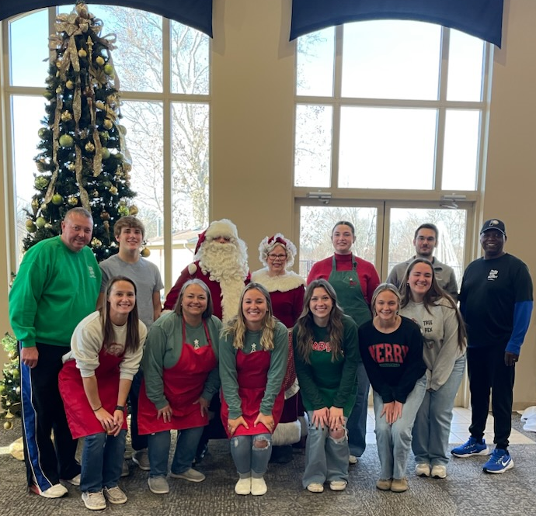
Happy Holidays from Franklin Parks and Recreation!!
(Some of our Staff!) Picture from Breakfast with Santa 2024!

