Slide 1
Franklin Parks and Recreation
October 2024 Park board Meeting

Slide 2
FACILITY Reservations
•Changes for the Aquatic Center concession stand are getting started. We will be taking out the old sinks, a small table, relocating a cupboard, taking out a small counter top, and moving equipment around. Curtis is working on all of this for us and doing it in-house.
•Early voting starts in the Theater Room on Monday, October 21st. There will be voting every day except on Sundays at the Rec Center.
•All of the refunds have been submitted for Fall Festival booths. We ended up moving 16 booths to the Vintage Fest the following weekend for some of our vendors. I have also sent them some options for other events where they could possibly set up booths at to help them out.
- Jamie

Slide 3
Marketing
Instagram: @franklinparksin
Follower Count: 1,714 (+13)
Most liked post: Indiana bones at the dog park
Number of likes: 58
Number of comments: 0
Number of Sends: 4
Accounts reached: 659
Facebook:
Franklin Parks & Recreation
Follower Count: 17, 552 (+280)
Like Count: 14,328 (+136)
Most liked post: Fall festival cancellation
Number of Likes: 535
Number of shares: 276
Number of comments: 122
Twitter (x): @franklinparksin
Follower Count: 1,059 (+2)
Most liked post: Fall Festival poster
Number of Likes: 2
Number of Impressions: 100
Number of replies: 0
TikTok: @franklinparksin
Franklin Parks & Recreation
Follower Count: 1,003 (+2)
Like Count: 1,841 (+78)
Most viewed post: “Indiana bones video”
Number of views: 980
Number of likes: 39
Number of saves: 1
Number of comments: 1
As of Oct. 10th

Slide 4
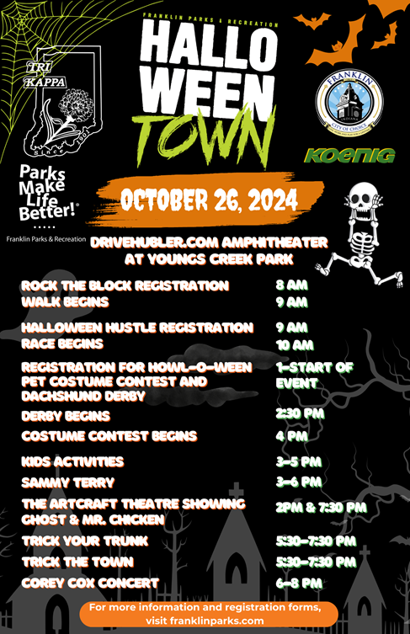
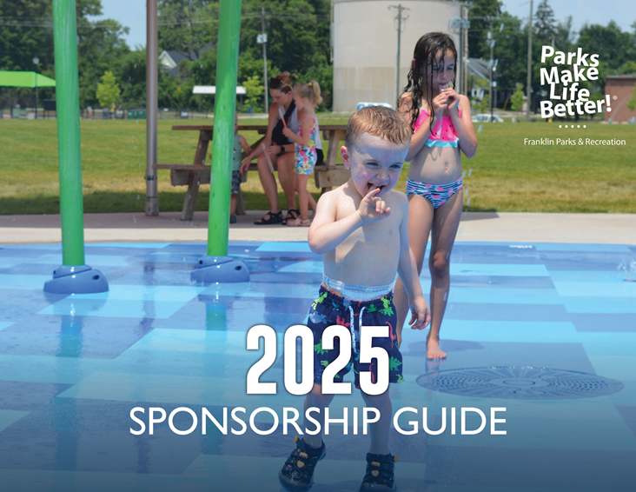

Slide 5
Recreation pROGRAMS CONTINUED
COMMUNITY GARDEN
We only have a couple weeks left for the community garden. The maintenance guys will be mowing and tilling it to start fresh next year.
OUR TOWN PLAYERS
They are currently holding auditions at the Recreation Center for ‘It’s A Wonderful Life”
Their next show is “The Brothers Grimm Spectaculathon!”
Fridays and Saturdays @ 7:30 PM // Sundays @ 2:30 PM
October 25-27 at the Johnson County Museum of History
November 1-3 at the Church of Jefferson
REC PROGRAMMING
The wood fall signs class is on 10/23 there are 15 spots in this class.
Preschool Play is starting up again on 11/12.
Brews and Brushes will be at Shale Creek on 11/21 this class is in partnership with the Public Arts Advisory Commission.
We rescheduled the Dive-In movie “Luca” for 12/20.
- Courtney

Slide 6
RecreatioN, Events, & pROGRAMS
Pottery class Both adult and child classes are full. 1st class begins 10/15.
Hikes with Tykes 1st session started on 10/10. 2 participants for the first session. We were able to get photos of the activities during the session to use for further marketing of the program.
Campfire Flames and Games free community drop in program on 10/11. Will keep a tally of participant total to see if there is an interest for free “smaller” events in the community.
Franklin Friends First session starts on 10/29. Receiving donation of 10 pumpkins from Kelsay Farms to use for the arts activity for the month.
-Nick

Slide 7
Community events
PROGRAMMING:
Fall Festival was cancelled for the first time since I can remember. After much thought, conversations with police and fire departments, reports from the National Weather Service, we decided to error on the side of caution and cancel the festival. It was a hard decision to make but I feel it was the right one. We had a lot of support from the community even though everyone was sad. We did have some ask if it would be rescheduled. This is not easy with an event the size of the Fall Festival. There are state permits that have to be changed, entertainment rescheduled, vendors rescheduled, etc. We did try to reschedule as many “parts” of the festival to Halloween Town on Saturday, September 26th. The Dachshund Derby, Rock Around the Block and one of the concerts (Cory Cox) have been rescheduled. We had 15 craft vendors participate in the Fall Vintage Fest on October 5th. We offered it to those vendors who qualified as “vintage, homemade or homegrown.”
We showed “Hotel Transylvania” on Friday, October 4th and had a great crowd. We are going to make a Halloween movie a tradition in early October every year.
We are gearing up for the final stretch for 2024 with the following:
Saturday, October 26 Halloween Town
Saturday, December 7 Holiday Lighting
Sunday, December 8 Santa Paws
Saturday, December 14 Breakfast with Santa
CONCESSIONS:
We have cleaned and are putting things away for the winter. Curtis will be fixing some areas of the pool concession stand in the next month.
-Holly

Slide 8
Community events continued
Concert Series
Festival Country Indiana, Title Sponsor ($10,000)
Cornett Roofing, Beer & Wine Garden Sponsor ($7,500)
Horizon Bank, Gold Sponsor ($5,000)
Lambert Orthodontics, Gold Sponsor ($5,000)
Franklin Jewelers, Gold Sponsor ($5,000)
Compass Park, Gold Sponsor ($5,000)
Huston Electric ($5,000 In Kind)
Max Service Group, Silver Sponsor ($2,500)
Franklin Insurance, Silver Sponsor ($2,500)
Culligan ($2,500 In Kind)
Small Town Girl Boutique, Booth Sponsor ($500)
Farley Health Solutions, Booth Sponsor x 2 ($1,000)
Merrified Exteriors, LLC, Booth Sponsor ($500)
Easter Egg Hunt
Community Baptist Church, Title Sponsor ($750)
Koenig Equipment, Candy Sponsor ($250)
Cruisin’ the Amp
Firecracker Festival
Johnson County CASA Program, Red Sponsor ($2,500)
Miss M’s Home and Garden, Red Sponsor ($2,500)
Fall Festival
Carpenter Realty, Gold Sponsor ($2,500)
Royalty Roofing, Bronze Sponsor ($500)
Halloween Town
Koenig Equipment, Bronze Sponsor ($500)
Family Movie Series
Johnson County REMC, Title Sponsor ($5,000)
SPONSORSHIPS AND GRANTS:
Sponsorships for 2024 are below. 2025 sponsorship packets will be going out in the next few weeks. Please let me know if you have anyone we should contact.
Eclipse Festival
Festival Country Indiana, Title Sponsor ($15,000)
Huston Electric ($2,500 In Kind)
Koenig Equipment, Half Moon Sponsor ($1,000)
Arts @ The Amp
Grant and Art Programming Partnership with the Public Arts Advisory Commission from the Branigin Foundation for $5,500
-Holly

