Slide 1
Franklin Parks and Recreation
January 2025 Park board Meeting

Slide 2
FACILITY Reservations
•Our numbers for concession stand applications are very low. We only have about 10 so far and will need at least double that. The pool concession stand construction project is still ongoing.
•All rental fees have been changed in the computer system, on the website, rental forms, and on our advertising screens.
•Our maintenance guys will be coming in soon to look at painting rental facilities that need it and touching up any rooms that may have some issues.
•All calendars for 2026 have been made for all rental facilities because we rent up to a year in advance. We can already take reservations for beginning of 2026 right now!
- Jamie

Slide 3
Marketing
Instagram: @franklinparksin
Follower Count: 1,789 (+9)
Most liked post:Holiday lighting Tiktok
Number of likes: 38
Number of comments: 0
Number of Saves: 1
Accounts reached: 883
Facebook:
Franklin Parks & Recreation
Follower Count: 17,691 (+24)
Like Count: 14,385 (+16)
Most liked post: Friendship Bracelet picture
Number of Likes: 53
Number of shares: 2
Number of comments: 6
Twitter (x): @franklinparksin
Follower Count: 1,059 (+2)
Most liked post: Holiday lighting video
Number of Likes: 12
Number of Impressions: 600
Number of replies: 1
TikTok: @franklinparksin
Franklin Parks & Recreation
Follower Count: 1,012 (+2)
Like Count: 1,947 (+5)
Most viewed post: Holiday Lighting video
Number of views: 933
Number of likes: 45
Number of saves: 1
Number of comments: 1
As of Jan 7th

Slide 5
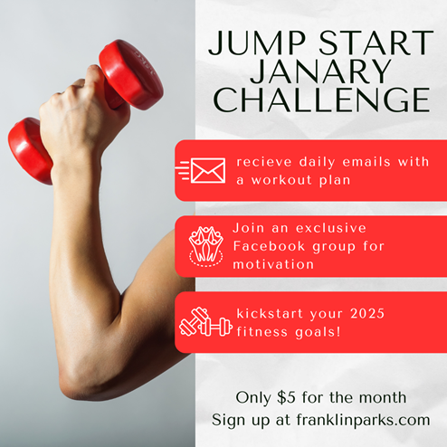
Promoted 2025 rental bookings on social media.
Created and promoted a Recreation Programs survey
Helped implement and promote a monthly fitness challenge program.

Slide 6
FITNESS AND AQUATICS
Aquatics
As of now, we have 19 returning guards actively starting the re-hire process.
Lifeguarding Classes and Returning Guard Skills Checks are being scheduled and waiting on the schools for date confirmations.
Group Fitness Classes
Platinum Zumba, Aqua 2.0, Total Body Reset, CycleFit, and Zumba Toning
- Alfonso

Slide 7
Recreation pROGRAMS
KICKAPOO KIDS CAMP
I sent out the registration email reminder to over 400 emails. Followed up by many emails from people who would love information about KKC.
I have also received over 20 applicants for new counselors and 12 returners so far.
- Courtney

Slide 8
Recreation pROGRAMS
COMMUNITY GARDEN
Currently looking over the packet agreement for the community garden and the guidelines that are in place.
OUR TOWN PLAYERS
OTP Members are setting up a meeting with Chip and myself to discuss plans for the 2025 show season. The following three shows are confirmed for this year.
A Wedding From Hell
Our Town
An Evening of Shorts and One Acts (Potentially a dinner theater)
PRESCHOOL PLAY
Its is still going amazing! Victoria is doing great at promoting it on our social medias.
PAAC and Art Programming
I am working with PAAC to have some more painting classes with Greg Potter. PAAC has a meeting next week to discuss other Art Programming around the city with this partnership.
- Courtney

Slide 9
RecreatioN, Events, & pROGRAMS
Random Acts of Kindness Food Drive- To celebrate Random Act Kindness Day on February 17th, we will be setting up bins to accept donations for a food drive to donate to the Interchurch Food pantry of Johnson County. Looking to have donation bins setup in the rec center lobby starting January 27th and items will be donated on February 17th.
Winter Euchre Tournament- Holding another Euchre Tournament on February 20th.
Hikes with Tykes programs for March are planned out. Working on plans for the April sessions now.
Pottery basics- Still looking for a new instructor to hold this class again. Will ask the public arts council if they have known any artists that may be interested if I don’t have any art students from Franklin College who are interested.
Adult Beginners Ballet- Class will start in April and go through May. Ballet instructor is interested in doing a class in the fall as well if the Spring class is successful.
Woodcarving class will be a 6 week class with both an adult and child session. Confirmed the instructors availability to have the class in August-September. Working on creating a materials list with costs included with the instructor so I can create a budget and program price.
-Nick

Slide 10
Community events
PROGRAMMING:
2025 is here and we are ready for another busy and fun year! Booking concerts for this summer has been different and there have been many changes but they are almost set. The Branigin Foundation continues to support our Arts at the Amp series and I am planning for that. Nick and I are looking for a few new things for this series.
I am looking forward to our Bejeweled: A Taylor Swift Eras Party which will be held on January 24th. It will be a fun night filled with music, bracelet making, dancing, pictures, food and fun.
SPONSORSHIPS AND GRANTS:
2025 sponsorship packets have gone out and we are starting to get them back. Below are the sponsors we have secured so far. Please let me know if you have anyone we should contact.
Sponsor List for 2025
Concert Series
Festival Country Indiana, Title Sponsor ($10,000)
Compass Park, Gold Sponsor ($5,000)
Franklin Jewelers, Gold Sponsor ($5,000)
Huston Electric ($5,000 In Kind)
Franklin Insurance, Silver Sponsor ($2,500)
Culligan ($2,500 In Kind)
Easter Egg Hunt
Community Baptist Church, Title Sponsor ($750)
Cruisin’ the Amp
Firecracker Festival
Fall Festival
Halloween Town
Family Movie Series
Hubler Group Amphitheater Sponsorship ($25,000)
Johnson Memorial Hospital Pickleball Sponsorship ($25,000)
Branigin Foundation Street Sponsorship ($10,000)
Branigin Foundation Arts at the Amp Series and programming with the Franklin Public Arts Advisory Committee ($5,500)
CONCESSIONS
Hoping for some great candidates to work this summer.
-Holly

Slide 11
HUMAN RESOURCES REPORT
-Brooke

