Slide 1
Franklin Parks and Recreation
March 2025 Park board Meeting

Slide 2
FACILITY Reservations
Holly and I are in the middle of hiring for concessions. We are having a staff of 35 employees between Scott Park and the Pool. The Scott Park season starts on April 12th so we are having all returning staff get their stuff done soon to get them ready for that season and then all new hires will be on the payroll after that.
The Pool concession stand is about ready will all of the changes and then we will start getting that cleaned up and ready for training at the beginning of May.
I am helping get all of the lifeguards hired for this summer since the Aquatics Coordinator is leaving. I’ve been going through those applications and trying to get that staff ready for summer as well. We are looking at hiring around 27 lifeguards this year.
All outdoor rentals will be starting the last weekend in April. Park restrooms have been opened for the year so maintenance will be getting shelters and picnic sites ready to start being reserved in the next month.
- Jamie

Slide 3
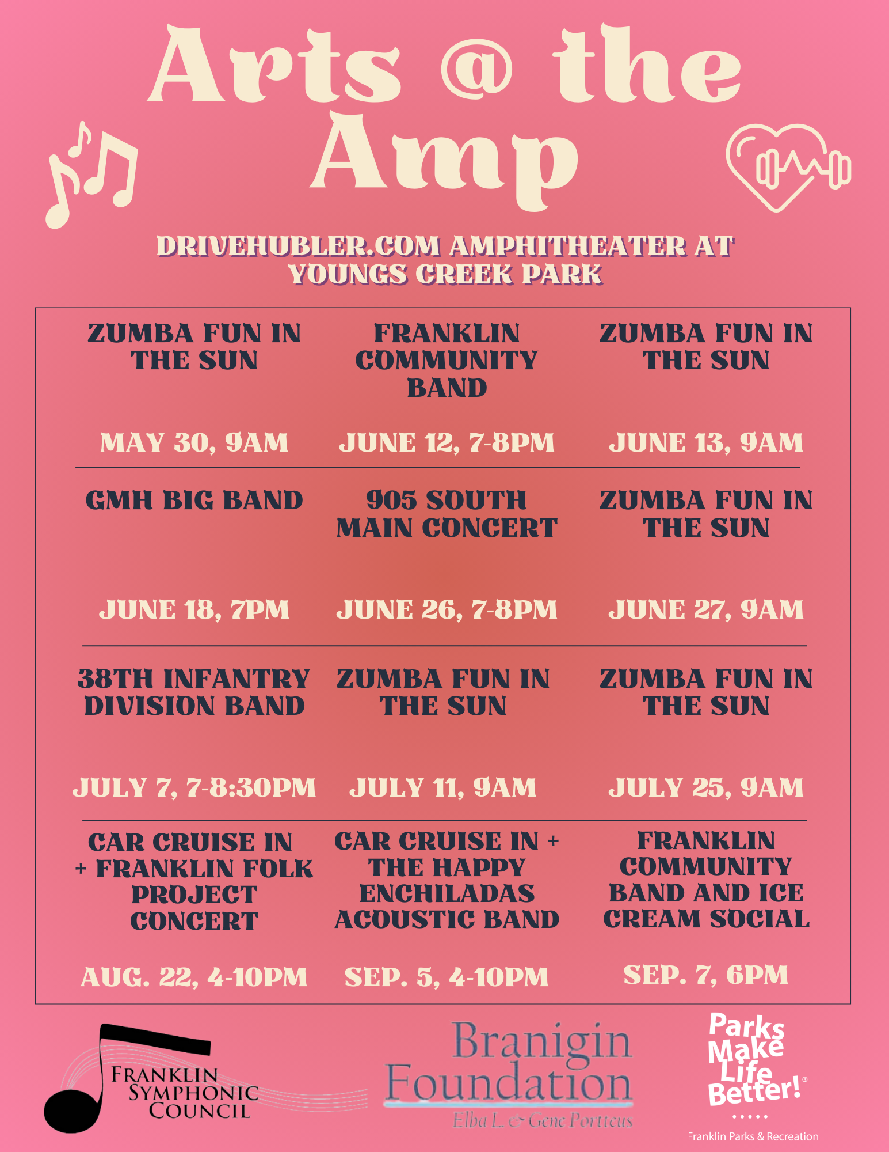
Newsletter stats- (March Newsletter, sent Feb. 26th)
Sent: 3569
Opened: 1641 (49%)
Clicked: 134 (8%)
Most opened links:
Summer Concert Series Flyer
March Fitness Calendar
Chair Zumba
Adult Ballet

Slide 4
- Victoria
Facebook:
Franklin Parks & Recreation
Follower Count: 17,807 (+29)
Like Count: 14,404 (+10)
Most liked post: Pickleball Nets are officially now up.
Number of Likes: 105
Number of shares: 24
Number of comments: 16
Instagram: @franklinparksin
Follower Count: 1,869 (+26)
Most liked post: Pickleball Nets are officially now up
Number of likes: 43
Number of comments: 0
Number of Saves: 0
Accounts reached: 600
Twitter (x): @franklinparksin
Follower Count: 1,061 (+2)
Most liked post: Summer Concert Series Announcement
Number of Likes: 8
Number of Impressions: 790
Number of replies: 0
TikTok: @franklinparksin
Franklin Parks & Recreation
Follower Count: 1,012 (-2)
Like Count: 2,018 (+10)
Most viewed post: Hiring Lifeguards
Number of views: 347
Number of likes: 9
Number of saves: 0
Number of comments: 1
As of March 20th

Slide 5
Recreation pROGRAMS CONTINUED
KICKAPOO KIDS CAMP
We have picked our two coordinators: Gabi Sherry and Jolie Engleau.
They both have been working with camp for three years. This will be Gabi’s second year as a coordinator.
We will have 18 returning counselors
Four new (first year counselors)
Interviews will conclude today.
All staff with me contacted 3/27 to come in and do paperwork.
We will be planning a date for Counselor Training/CPR for all staff once everyone is on payroll.
Payments for campers are coming in and allowing me to get decorations, plan field trips, and prep for every day camp.
Camp is 65 Days Away!
- Courtney

Slide 6
Recreation pROGRAMS CONTINUED
COMMUNITY GARDEN
They went on sale March 1st, we have two traditional beds left and three raised beds. The others are all spoken for.
We will be numbering the beds with black vinyl soon!
OUR TOWN PLAYERS
Their spring show is next month! We are working on an easier way to get online ticket sales. It will be in Beeson Hall.
They have added a Summer and a Christmas show for 2025.
PAAC and Art Programming
I am in contact with local artist to do a couple painting classes!
- Courtney

Slide 7
RecreatioN, Events, & pROGRAMS
Programs
Beginners Ballet starts in April and goes through May. Class is full in April and 3 spots left in May.
Free Bike Safety program is on April 3rd at Creekside Shelter. In partnership with Johnson County Health Dept. to give out free bike helmets, teach about bike safety, and a spring craft.
Spring Fling Adaptive Dance is on April 11th. Had Meeting with special education representatives to talk about plans for the dance. They are going to help out with setting up crafts, bring food, and help sign up students.
Summer Ukulele Class is open to start registering. Our instructor for the class is lending ukuleles for students to use during the class if needed.
Non- City Events
More Cruise Ins and 5K walks and runs are being planned.
-Nick

Slide 8
Community events
PROGRAMMING:
We are all booked and ready to go for the busy season this year. There are a few details that are still being figured out but we are ready.
CONCESSIONS
Little League will start playing games at Scott Park the weekend of April 12th. We will start cleaning and stocking out there when the water is turned on. Curtis has a few more things to do at the pool concession building and then we will get started in there.
SPONSORSHIPS AND GRANTS:
2025 sponsorship packets have gone out and we are starting to get them back. On the next slide are the sponsors we have secured so far. Please let me know if you have anyone we should contact.
-Holly

Slide 9
Community events continued
Sponsor List for 2025
Concert Series
Festival Country Indiana, Title Sponsor ($10,000)
Earl Gray & Sons, Beer & Wine Garden Sponsor ($7,500) **NEW
Compass Park, Gold Sponsor ($5,000)
Franklin Jewelers, Gold Sponsor ($5,000)
Huston Electric ($5,000 In Kind)
Campbell Shuck Insurance, Silver Sponsor ($2,500)
Franklin Insurance, Silver Sponsor ($2,500)
Culligan ($2,500 In Kind)
Horizon Bank, Silver Sponsor ($2,500)
McGath Concrete Construction Corporation, Silver Sponsor ($2,500)
Horizon Bank, Booth Sponsor ($500)
Ivy Tech Community College ($500) **NEW
Martin Orthodontics ($500) **NEW
Easter Egg Hunt
Community Baptist Church, Title Sponsor ($750)
Cruisin’ the Amp
Winters Plumbing, Gold Sponsor ($1,500)
Firecracker Festival
Fall Festival
Winters Plumbing, Gold Sponsor ($2,500)
Martin Orthodontics, Silver Sponsor ($1,000) **NEW
Halloween Town
Family Movie Series
JCREMC/JCFiber, Title Sponsor ($5,000)
Franklin Family Aquatic Center
Vaught Family Eye Care, First Aid & Sunscreen Sponsor ($500)
Lambert Orthodontics, Souvenir Cub Sponsor ($1,000)
Hubler Group Amphitheater Sponsorship ($25,000)
Johnson Memorial Hospital Pickleball Sponsorship ($25,000)
Branigin Foundation Street Sponsorship ($10,000)
Branigin Foundation Arts at the Amp Series and programming with the Franklin Public Arts Advisory Committee ($5,500)
-Holly

